Slide 1
GEOIDE
Geomática para Decisiones Inteligentes
(GEOmatics for Informed DEcisions;
Géomatique pour des Interventions et Décisions Éclairées)
Notes:
Dans les trois langues

Slide 2
¿Que es GEOIDE?
GEOIDE (Geomática para Decisiones Inteligentes)
  Financiada por el programa de Redes de Centros de Excelencia (RCE) del gobierno de Canada
  Reúne a muchos de los más destacados expertos del mundo
  Colabora con organizaciones internacionales (9 al mundo)
GEOIDE creado en 1998; once años de éxitos.
Notes:
GEOIDE (GEOmatics for Informed DEcisions)
GEOIDE is funded by the Networks of Centres of Excellence program (NCE) since 1998. The GEOIDE Network is made possible through the funding of the Networks of Centres of Excellence program (NCE). Networks of Centres of Excellence are unique partnerships among universities, industries, government and non-profit organizations aimed at turning Canadian research and entrepreneurial talent into economic and social benefits for all Canadians. An integral part of the federal government's Innovation Strategy, these nation-wide, multidisciplinary and multisectorial research partnerships connect the research community with industrial know-how and strategic investment.
GEOIDE brings together many of the country’s leading experts from universities, industry and government agencies to conduct world-class research to enhance Canadians lives. In addition, GEOIDE promotes international collaborations with similar organizations worldwide.
The mission of GEOIDE is to consolidate and strengthen the Canadian geomatics industry, while making optimum use of Canada’s Research and Development resources. GEOIDE aims to create a sustainable networking structure that integrates all sectors of the Canadian geomatics community. As a result, Canada can continue to play a leading role in geomatics worldwide.
2

Slide 3
El programa RCE
Es un programa permanente del Gobierno de Canadá que apoya la investigación en las universidades y hospitales en asociación con los sectores privados y públicos.
Fomentar sinergias entre creadores, usuarios y receptores de conocimiento
Aborda complejas aéreas de importancia crítica de Canadá
Investigación multidisciplinaria, desde básica a aplicada, en una variedad de disciplinas.

Slide 4
Geomática: ciencia interdisciplinaria
En resumen, es acerca de:
Localización, localización, localización
  Agrimensura, geodesia, GPS
  Fotogrametría, teledetección, sensores (captores) distribuidos…
  Y cartografía
Pero más que eso, es sobre el análisis de la información espacial :
  Sistemas de información geográfica, geo-demografía, análisis de riesgos, toma de decisiones
  y toda ciencia que esté relacionada con bases de datos espaciales

Slide 5

Participantes (Fase III 2005-09)
ORGANISATIONS
104
Canada
12
32
Europe
Americas
20
4
13
UNIVERSITIES
8
Asia and
Australia
Notes:
Phase III funded 133 researchers at 32 universities in 8 provinces across Canada. These researchers represent diverse disciplines. Collaboration has been established with researchers in the Americas, Europe, Asia and Australia.

Slide 6
Capital humano avanzado (HQP)
En Fase III, los proyectos de GEOIDE apoyaron a muchos estudiantes hasta la obtención de su diploma
Nivel del estudiante | Completado | Actual
Licenciatura | 191 | 54
Estudiantes posgrado (MSc & PhD) | 575 | 241
Estudiantes Posdoctorales | 93 | 28
Notes:
From Table 1.1 (page 208);
GEOIDE Table 4 in stats
Fiscal Year 2007-08 - Exercice financier 2007-08
Table 4: Number of Graduate Students Working on Network Research
Graduate Students/ N. of students/ N. of thesis completed/
PhDs / Doctorats
Male / Homme 1:Canadian / Canadiens** 43 7 2:Foreign / Étrangers 56 9
Female / Femme 3:Canadian / Canadiens** 22 4 4:Foreign / Étrangers 13 2
Total (PhD) 134 (99M/35F) 22 (completions) 15M 6 F
Masters / Maîtrises
Male / Homme 1:Canadian / Canadiens** 68 14 2:Foreign / Étrangers 35 4
Female / Femme 3:Canadian / Canadiens** 32 4 4:Foreign / Étrangers 15 2
Total (Masters) 150 (103M/47F) 24 (18M/6F)
All students 2007-08: 284 (202M / 82F) (29% F in total)

Slide 7
La forma en que GEOIDE trabaja:
Una red de redes
GEOIDE Estructura de la red
  Cada proyecto es una mini-red
    El interés principal es pluridisciplinario
    Los diversos centros se encuentran diseminados a través de Canadá
      Sector Académico (32 universidades)
      Industria (40 compañías afiliadas)
      Gobierno (64 entidades públicas o gubernamentales)

Slide 8
Red international
    CRCSI (Australia) (renovelado hasta 2017)
    CentroGeo (Mexico)
    MAGIS (fué SIGMA – Cassini) (CNRS GdR, Francia)
    Korean Land Spatialization Group (Coréa)
    Future Position X (Sweden)
    NCG (Irelandia) ahoraStratAG
    AGILE (Association of Geographic Information Laboratories in Europe)
      96 miembros - 20 paises
    Instituto Panamericano de Géografia y Historia (Organization of American States) 21 paises
    UCGIS (University Consortium for GIScience – USA)
    RGI (Netherlands) (funding not renewed 2009)

Slide 9
Cómo funciona GEOIDE
Red de investigación construida sobre distintas fortalezas para obtener múltiples resultados
NCE
Resultados :
Socios
GEOIDE
Comercialización
Proceso decisional
Proyectos
Ciencia
Propuestas
Beneficios sociales
Investigadores
Afiliados (Gob, industria)
Proyectos abarcan participantes en Universidades, Industria, Gobiernos, Organizaciones sin fines de lucros, etc.
Estudiantes

Slide 10
Como fonctiona uno proyecto GEOIDE
Grupo de trabajo distribuido
  Universidad 1: investigadores, estudiantes
  Universidad 2: laboratorio, investigadores, estudiantes…
  Gobernio: investigadores, usadores
  Empresas: investigarodes, usadores…

Slide 11
Funcionamiento (2)
Division de trabajo entre actores
  estudiantes, técnicos e investigadores
Comunicacion entre actores
  talleres, visitas, intrecambios (cotutelle)
Gestion cientifico: GEOIDE
Resultados: cientificos, comerciales …

Slide 12
Project 1
University 1
University 2
University 3
Gov 1
Gov 2
Industry 1
NFPO
Notes:
Structure of a project
Academy
Gvts
NFPO
Industry

Slide 13
Project 1
University 1
University 2
University 3
Gov 1
Gov 2
Industry 1
NFPO
Prof 1
Prof 2
Prof 3
Prof 5
Prof 6
Prof 7
Prof 4
Notes:
In each university, the professors lead the research

Slide 14
Project 1
University 1
University 2
University 3
Gov 1
Gov 2
Industry 1
NFPO
Prof 1
Prof 2
Prof 3
Prof 5
Prof 6
Prof 7
Prof 4
Stud 4
Stud 1
Stud 5
Stud 3
Stud 2
Stud 6
Stud 7
Notes:
Throw those professors, GEOIDE funds their students. Mainly PhDs and Masters

Slide 15
Project 1
University 1
University 2
University 3
Gov 1
Gov 2
Industry 1
NFPO
Prof 1
Prof 2
Prof 3
Prof 5
Prof 6
Prof 7
Prof 4
Notes:
So here is a project

Slide 16
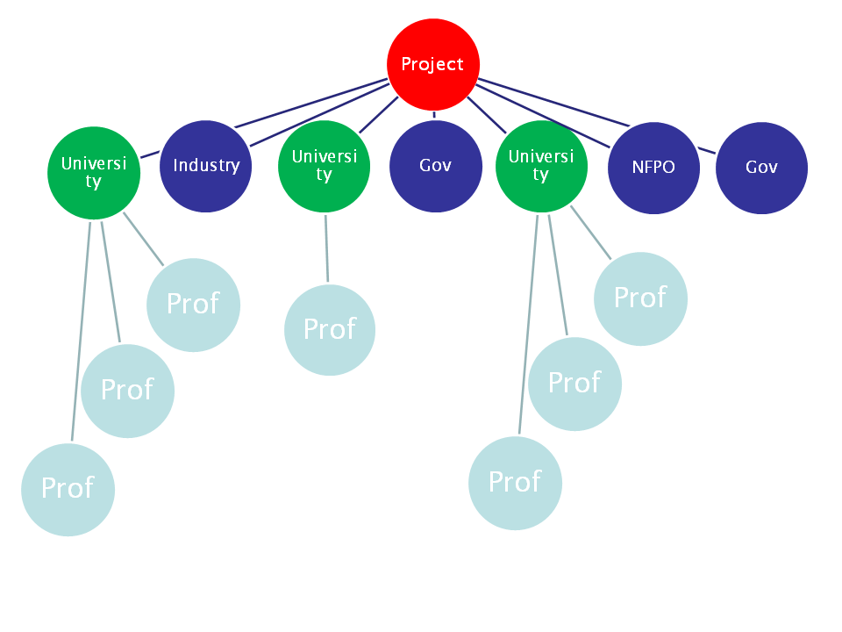
Notes:
GEOIDE funds differents projects

Slide 17
Notes:
Some professors could be in differents projects

Slide 19


Slide 20
Fase IV: (proyectos actuales)
Temas sobre Cambios Ambientales
3 proyectos

Slide 21
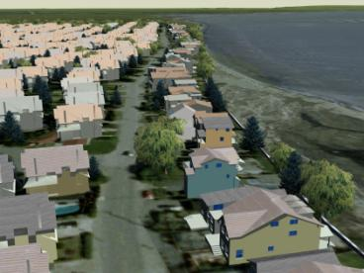
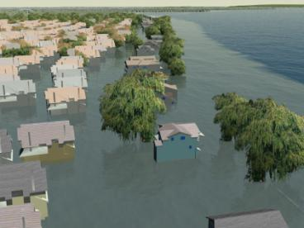
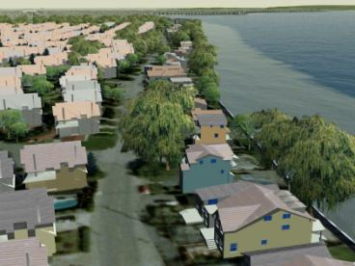
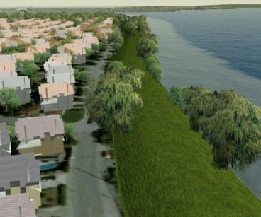
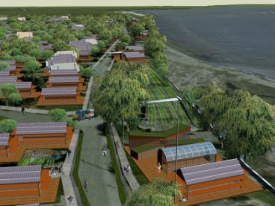


Herramientas que visualicen los cambios climáticos locales y los procesos en la toma de decisiones para las comunidades
Equipo:
  Canadá: UBC (2), Waterloo, Queen’s, Calgary (2), McMaster, UVic, Memorial
  Internacional: University of Colorado, Oxford, University of Wageningen- RGI, CSIRO- Australia, University of Washington, UCAR, CentroGeo- Mexico.
  Socios: Metro Vancouver, NRCan, Environment Canada, GeoBC, BC Ministry of Environment, Corporation Delta, District of North Vancouver, Calgary Regional Partnership, City of Toronto, Clean Air Partnership, ITTAQ Heritage and Research Centre, David Suzuki Foundation, … MORE THAN 15 (4 sites)!
Existing Condition
2100: Storm surge (3.48m)
2100: Wall Adaptation
2100: Dike Adaptation
2100: Resilient
low-carbon community
Pilot #32 – Sheppard
Notes:
The largest: Expected results in 4 study areas (sites) strong implication of foreign partners and local
Greater Vancouver region: sea level rise problems, local planning mitigations
Bow river (AB) : develop scenarios, drought/water
Toronto : heat waves, energetic needs
Clyde River : deglaciation, habitat change, sea level rise
Environmental scenarios of climate change for professionals and community representatives

Slide 22
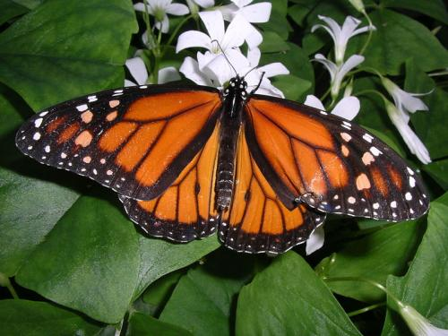
Geoweb Participativo para comprometer al público en los cambios climáticos globales
Equipo:
  McGill (3), Ryerson (2), UNB, UBC (2),
  Memorial
  Socios: Commission
  for Envir. Cooperation;
  Sierra Club ON; Pixsys;
  Gulf of Maine Council;
  City of Toronto; Microsoft; Kawartha Heritage Conservancy; NB Environment; NL Wildlife; BC Min. Forest (IAPP); Okanagan Water Board; Parks Canada; OCE
Pilot #41 – Sieber
Notes:
Expected output:
-Integration of environmental change models across platforms
-Engage geomatics and Web 2.0 developers (GeoWeb)
-Outreach to school

Slide 23
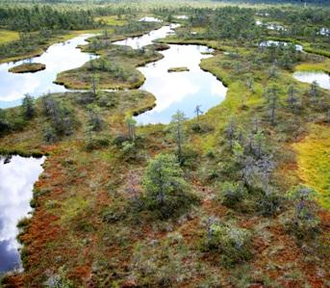
Modelamiento de la Dinámica del Bosque
Equipo:
  Canada: SFU (4), Western Ontario (4), Toronto, UVic (2), Montréal, Laval, UBC, Alberta, Calgary, Ottawa
  International: Michigan State, USFS, Centre for Environmental Research (Germany)
  Socios: Sustainable Resources AB; BC Forests; National Program in Complex Data Structures, MITACS (parallel request); Environment Canada, Ontario Ministry of Natural Resources, Sask. Environment; NRCan (Canadian Forest Service); TerraTree Forestry; Timberline; Feric; OCE
Pilot #43 – Dean
Notes:
Expected output:
-models of forest dynamics including stochastic element
-fire spread
-disease spread
-Predictive multivariate statistical models for fire in environment
-management actions
-extend to pest management
-sustainability and biodiversity issues

Slide 24
Fase IV:
Tema de Movilidad
5 proyectos

Slide 25
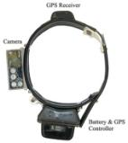
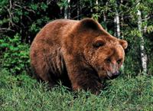
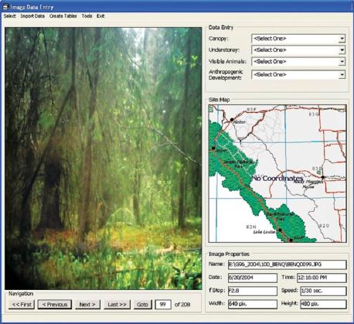
Sistemas de Multi-sensores para monitorear y aplicaciones de movilidad
Equipo:
  Canadá: Calgary (2), Royal Mil. Col., UVic, Ryerson, École Polytechnique, Saskatoon, Laval
  Internacional: AGILE, RGI, Madrid University, Taiwan University, Georgia Tech, University of New South Wales …
  Socios: Wireless Edge Canada Inc.; Hemisphere GPS; Foothills Model Forest; DRDC; Leica Geosystems; OCE
Source : GPS World, LBS
Pilot #3 – El-Sheimy
Notes:
Expected Output:
MEMS (nanotechnology) multi-sensors in Wildlife tracking; Automobiles; Dismounted soldiers; People with disabilities; Underwater; Space-time analysis of wildlife and human behavior

Slide 26
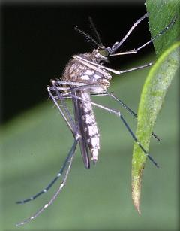
CODEGEOSIM
Herramientas de Geo-simulación para la simulación espacio-temporal de patrones de dispersión
y la evaluación de los efectos en la salud por enfermedades contagiosas
Equipo:
  Canadá: York (2), Queen’s (4), McMaster, Laval, Montréal
  Internacional : University of Maryland, CIRAD
  Socios: Environment Canada; Public Health Canada; INSPQ; IBM; Infonaut; ESRI Canada; Ministry of Health (ON); Cooperative Wildlife Health Centre; OCE; MITACS
Pilot #5 – Wu
Notes:
emphasize interdisciplinary
Expected output:
Dynamic geosimulation models of spatio-temporal spread of disease
control measures
vulnerabilities of communities
Four disease models: West Nile, Lyme disease, Avian flu, pandemic influenza

Slide 27
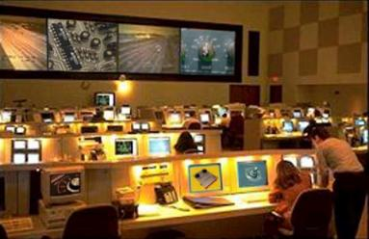
Redes de Vigilancia Tri-Dimensionales
Equipo:
  Canada: York (2),
  Waterloo (2), McGill,
  Calgary, Carleton, UBC
  Internacional: Seoul University, Inha University (South Korea)
  Socios: CAE; DRDC; Aeryon Labs; Aimetis; Applanix; Array Systems; Neptec; Sprung-Brett RDI; City of Toronto; Min Transport (ON); Honeywell; Miovision; Presagis; OCE
Pilot #17 – Elder
Notes:
Expected output:
- 3D models from ground
LiDAR
UAV cameras
Tracking people, events
face recognition
traffic flow estimation
Expected spin-offs to industrial partners; security industry

Slide 28
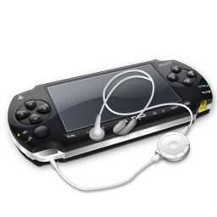
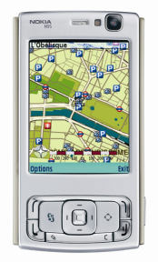

GéoÉduc3D: La Geomática al servicio de los video juegos y el aprendizaje
Equipo:
  Canada: Laval (7), Queen’s, SFU, Alberta; (+Curriculum expertise)
  Internacional: SIGMA, Université Jean Monnet, INRP, UC Santa Barbara, University of Nottingham, Delft University of Technology, Telecom Paris
  Socios: Ubisoft, Créaform 3D, Poly9, Ministère de l’éducation (QC)
Pilot #24 – Daniel
Notes:
Expected output:
- Design location-sensitive video game for portable devices
-Instruct players on environmental issues of their surroundings; outreach
- Better understanding of geomatics for gamers
Targeted education
Facts about UBISOFT
Ubisoft studios: 2nd largest in-house development staff in the world with 20 studios in 16 countries (incl Montréal and Québec)
Subsidiaries: In 28 countries
Distribution: In 55 countriesp
Staff: More than 4,750 collaborators worldwide (more than 3,900 dedicated to production)
Sales FY2007-08: 928 million euros
Ranking:
- 2nd independent publisher in Europe
- 3rd independent publisher in the U.S.
- 3rd independent publisher in the world, excluding Asia
Gaming portal: Ubi.com attracts 5 million unique visitors each month

Slide 29
Protección Pública y diseminación ética de los datos Geo-espaciales
Aspectos Sociales y jurídicos
Datos mashups (web 2.0)
Privacidad
Responsabilidad Civil
Calidad de la IG
Protección de la inversión y del copyright
Selección y uso de la IG
Equipo:
  Canada: Laval (2), Memorial, Ottawa (3), UNB
  Internacional: Université de Marne-la-Vallée, Maine, Melbourne, Leicester, (AGILE, CRCSI, SIGMA, UCGIS)
  Socios: Geoconnexions; Infrastructure Canada; CITS, Hydro-Québec; Groupe Trifide; EuroGeographics; Fisheries
  and Oceans Canada
Pilot #23 – Gervais
Notes:
Expected output:
Data quality and professional responsibility
legal concerns
design professional acts
work with other GEOIDE projects on data quality
Distinction droit coutumier/code civil napoléonien

Slide 30
¿Porqué estoy en Mexico?
Confirmar vinculos con CentroGeo
  Para continuar nuestros conneciones
  Para construir nuestro futuro
    Possibilidades en latin america
    NfN

