Slide 1
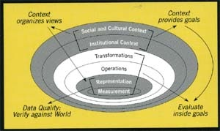
Sensor Integration and Knowledge Neworks
Nicholas Chrisman
Sciences géomatiques, Université Laval
Québec, Québec, CANADA
Scientific Director, GEOIDE Network

Slide 2
Outline of presentation
Bigger, faster, better? A story of advances
Sensors and Networks of Sensors…
  Some results from GEOIDE past projects
  What this may subvert / disrupt
Revisiting the I word: Information
Knowledge Networks

Slide 3
An open secret:
The power of GIS:
Integration of heterogeneous information
The threat of GIS:
Integration of heterogeneous information
Notes:
Le bon et le mal dérive des mêmes origines.

Slide 4
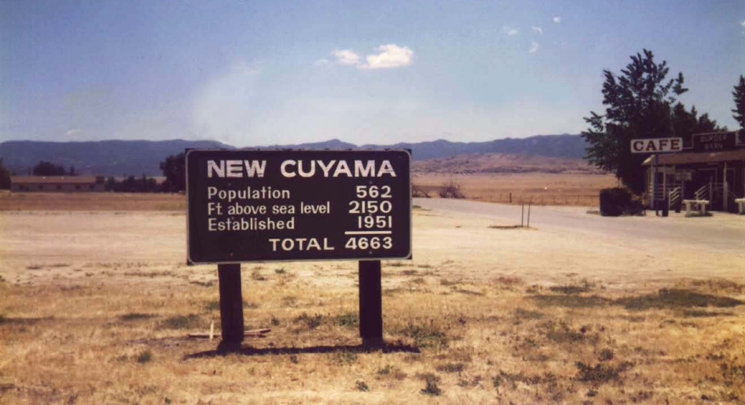
Everything is going to get:
Smaller
Faster
Greater capacity
More integrated
…
But, will this marvelous new world be any smarter?
Will we be stuck with the same old designs developed for a different set of conditions?

Slide 5
At the entry to New Cuyama, California
Integration at its most basic?
At least they know it is a joke.

Slide 6
Faster, faster, better?
Long-term trends in world economy
  (over 150 years or more)
    Faster communication
      reduce friction of distance,
      greater control from centers
    Greater use of information
      to drive out waste
      and for greater control and coordination
    Some counter directions as well, particularly recently.

Slide 7
Avoiding technological determinism
It is too easy to present new technology as a wave of the future that should not be resisted.
Technology involves many choices, and the path is not pre-ordained.
    Example: missile guidance (MacKenzie 1990)

Slide 8
Dante’s Inferno
(A guide to many explorations)
Starting from the center: Measurement –
Sensors
Peter Burrough observed that
Chrisman takes the path contrary to Dante

Slide 9
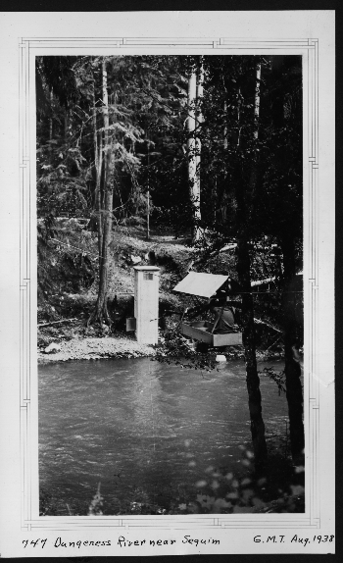
A river gage:
12048000 Dungeness River near Sequim WA
Location: Fixed
Time: Controlled
Height (of water): Measured
But how does the roll of paper get from the gage into use as a measurement?
Missing components: the guy with a pickup truck, and the digitizer- many steps…
Photo courtesy US Geological Survey
Notes:
As installed in 1938, swanky modern technology

Slide 10
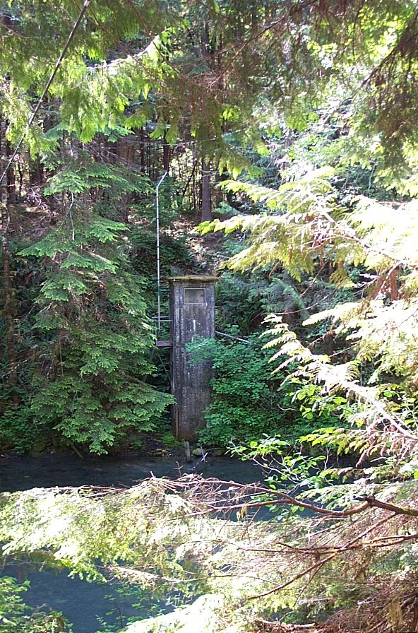
Advances in measurement
Astounding increase
    In spatial accuracy
    In speed of measurement
    In smaller sensors – everywhere
    In networks to connect sensors
But some promises have been hard to keep;
The « flood » of data from the sky has not overwhelmed our processing capacity.
Too much effort expended in replicating the old ways of seeing the world.
Notes:
As it looked 70 years later, a forgotten piece of rusting equipment?

Slide 11
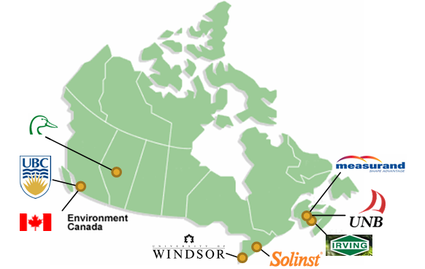
SII-73: SWAN
An Integrated Sensor Web for Watershed Monitoring
Sensors – with processing and networking power
Knowledge network across Canada

Slide 12
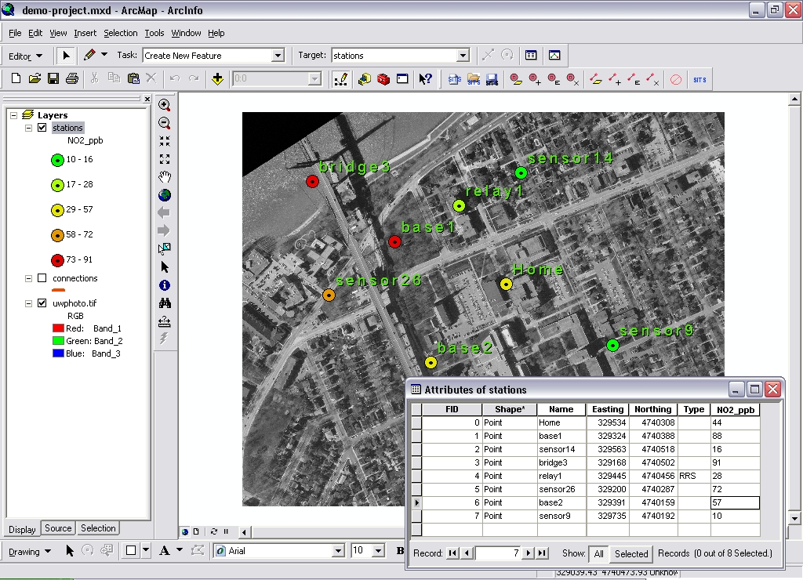
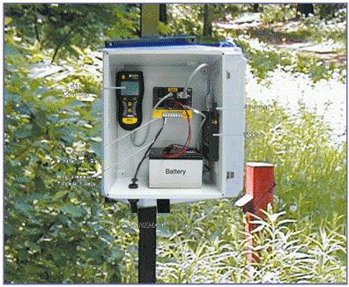
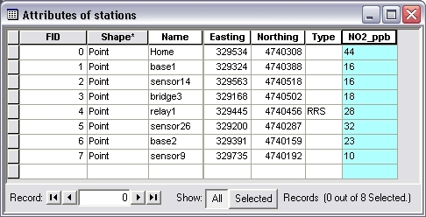
Sensors to suit
Motes
Batteries
Wireless
Solar panels?
One design environment, mixed hardware

Slide 13
And more recently,
Traffic Pulse (SII 89)
Part of the move to enroll citizen sensors (Volunteered GI)
Mobile telephones and mobile computing can provide improved understanding of urban traffic

Slide 14
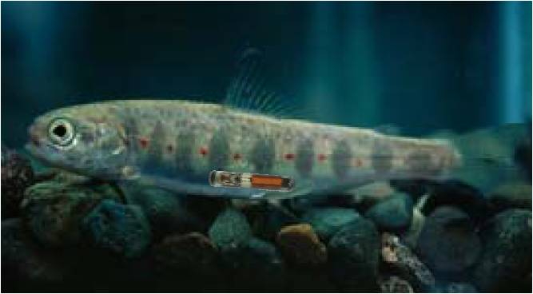
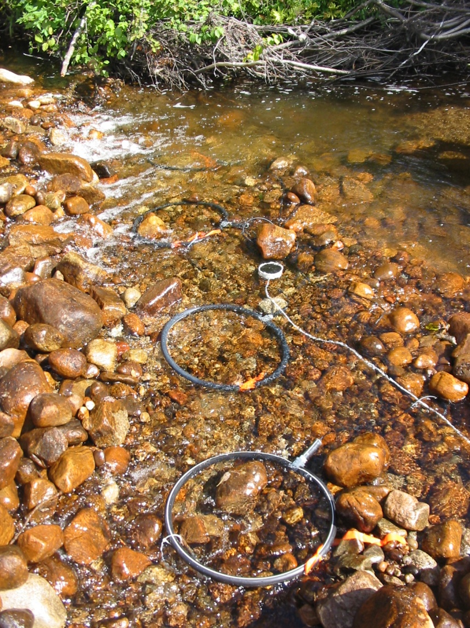
Sensors everywhere
Some examples
from GEOIDE past projects
PIT-tag inserted inside salmon juvenile (passive)
Antenna array (active) placed under the stream bed

Slide 15
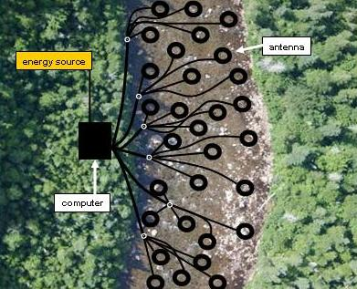
Results: a sensor network opens new science
256 antennas
one computer
energy from solar panels
network connection
As each fish swims over an antenna, its identity is recorded (in time and space).
Researchers have been able to observe new behavior –
beyond ‘stay’ and ‘leave’ : « commuters »
violates expected « minimum effort » models

Slide 16
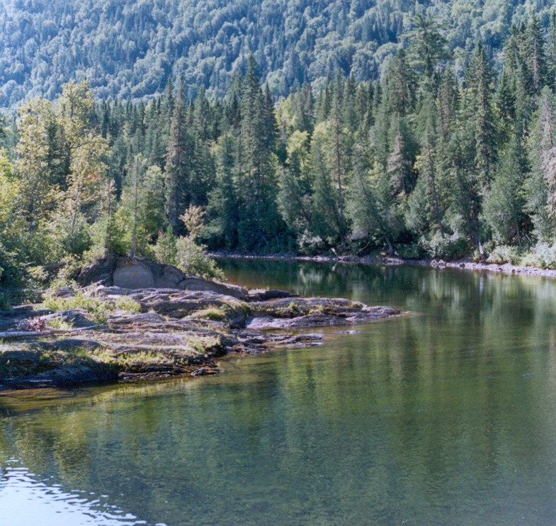
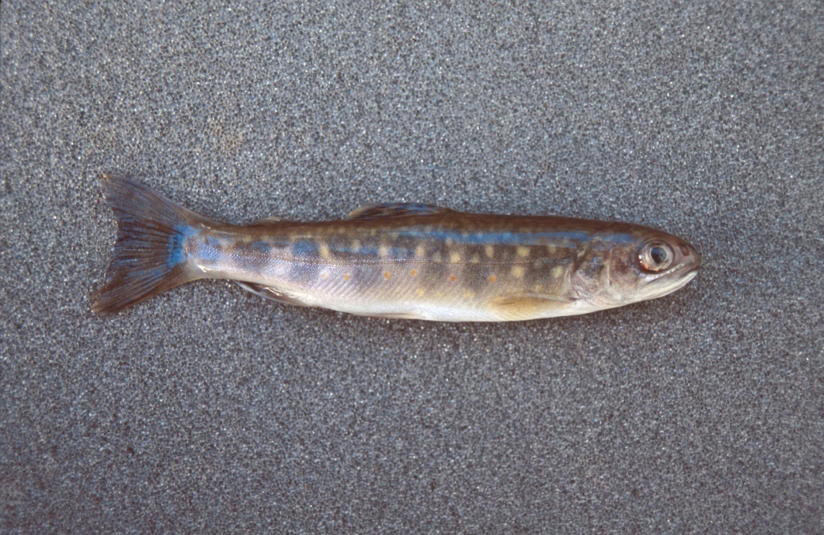
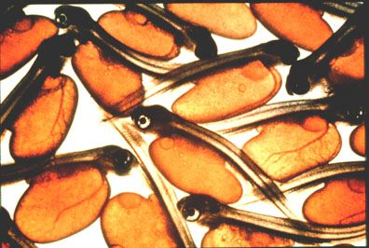

GEOSALAR: Understanding Atlantic Juvenile Salmon Movement and Migration in Rivers and Estuaries
This project aims at developing tools to:
Track and predict young Atlantic salmon movements among habitat;
Understand how time and stream morphology impact behaviour and reproduction.
Project No 14 Integrated Modelling of Juvenile Atlantic Salmon Movement and Physical Habitat in Fluvial and Estuarine Environments. Dr. Julian Dodson, Université Laval

Slide 17
GeoSalar – a knowledge network
Multiple disciplines:
  Salmon ecology
    Laval, UBC, UQ Rimouski
  Resource managers:
    MRNFQ, Dept Fish & Oceans Canada, BC ILMB. Hydro Québec
  Fishing interests (recreation and commercial)
    Atlantic Salmon Foundation, tribal bands, fishermen…
  Geomorphology (UQ INRS, McGill, Durham UK)
  Tracking technology (industry)
  Photogrammetry: videography (Genivar)
Results: for each participant- science, management, technology…

Slide 18
Distributed Sensor Networks- a potentially disruptive technology
Original GIS process:
  First, collect the data (centrally)…
  Then, work to extract the value
With sensor web:
  Send query to autonomous sensors
  Answers calculated by network…

Slide 19
Revisiting an old story
Assumptions about the trade-off:
  Compute / store
  [Eventually it is cheaper to reconstruct relationships than to store them and manage the interactions.]
  Example: topological data structure / shape file
  New dimensions of trade-off:
  Duplicate copies / transmit from center
  Band-width: Network makes it more complicated.
  Battery life, distributed energy cost (see band-width)
  Limited memory on handheld/ motes

Slide 20
What is so disruptive?
Sensor webs decentralize
It becomes impossible to start by collecting « all » the data…
Collaboration between collectors becomes central.
Raises issue of what information will be useful (to whom and when…)

Slide 21
The I in GIS
The middle word:
Not the one argued over…
Yet crucial.

Slide 22
Extract from a paper:
Order from Noise:
Towards a social theory of information
Barbara Poore, US Geological Survey
Nick Chrisman, GEOIDE

Slide 23
Two conflicting models of information
Both arise from Cybernetics movement in late 1940s
Shannon [Bell Labs] (publicized by Weaver)
    Transmission model: encoding as bits
Norbert Weiner [MIT, Lincoln Labs]
    Control of aircraft gunnery, cybernetics
    Feedback as main issue

Slide 24
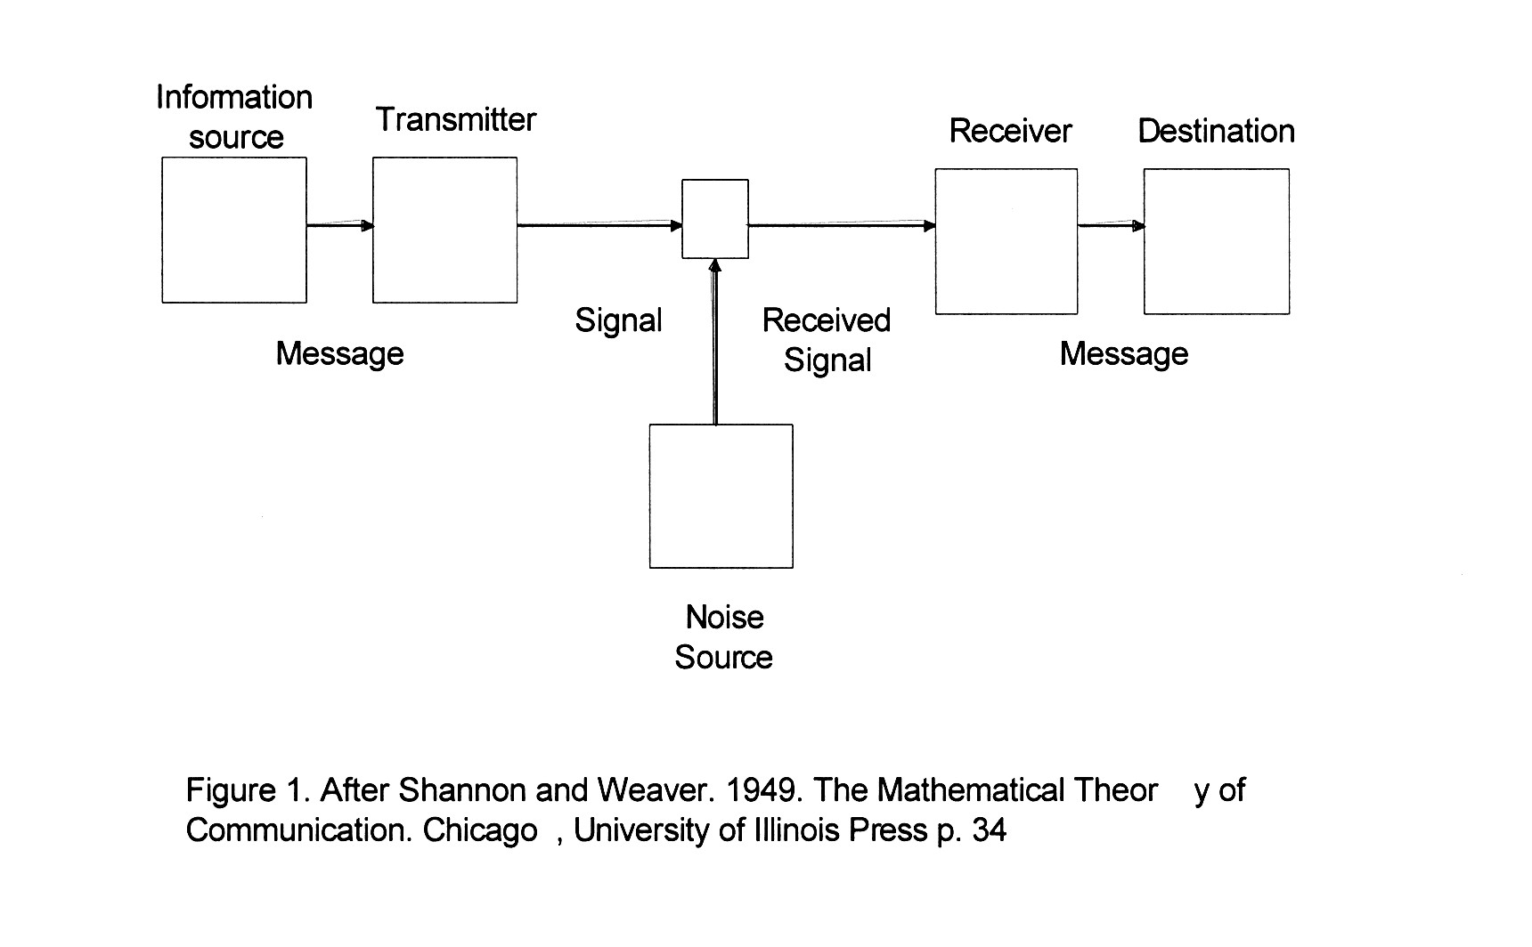
Shannon’s boxes and arrows
Invariance through transmission;
Meaning not a part of model

Slide 25
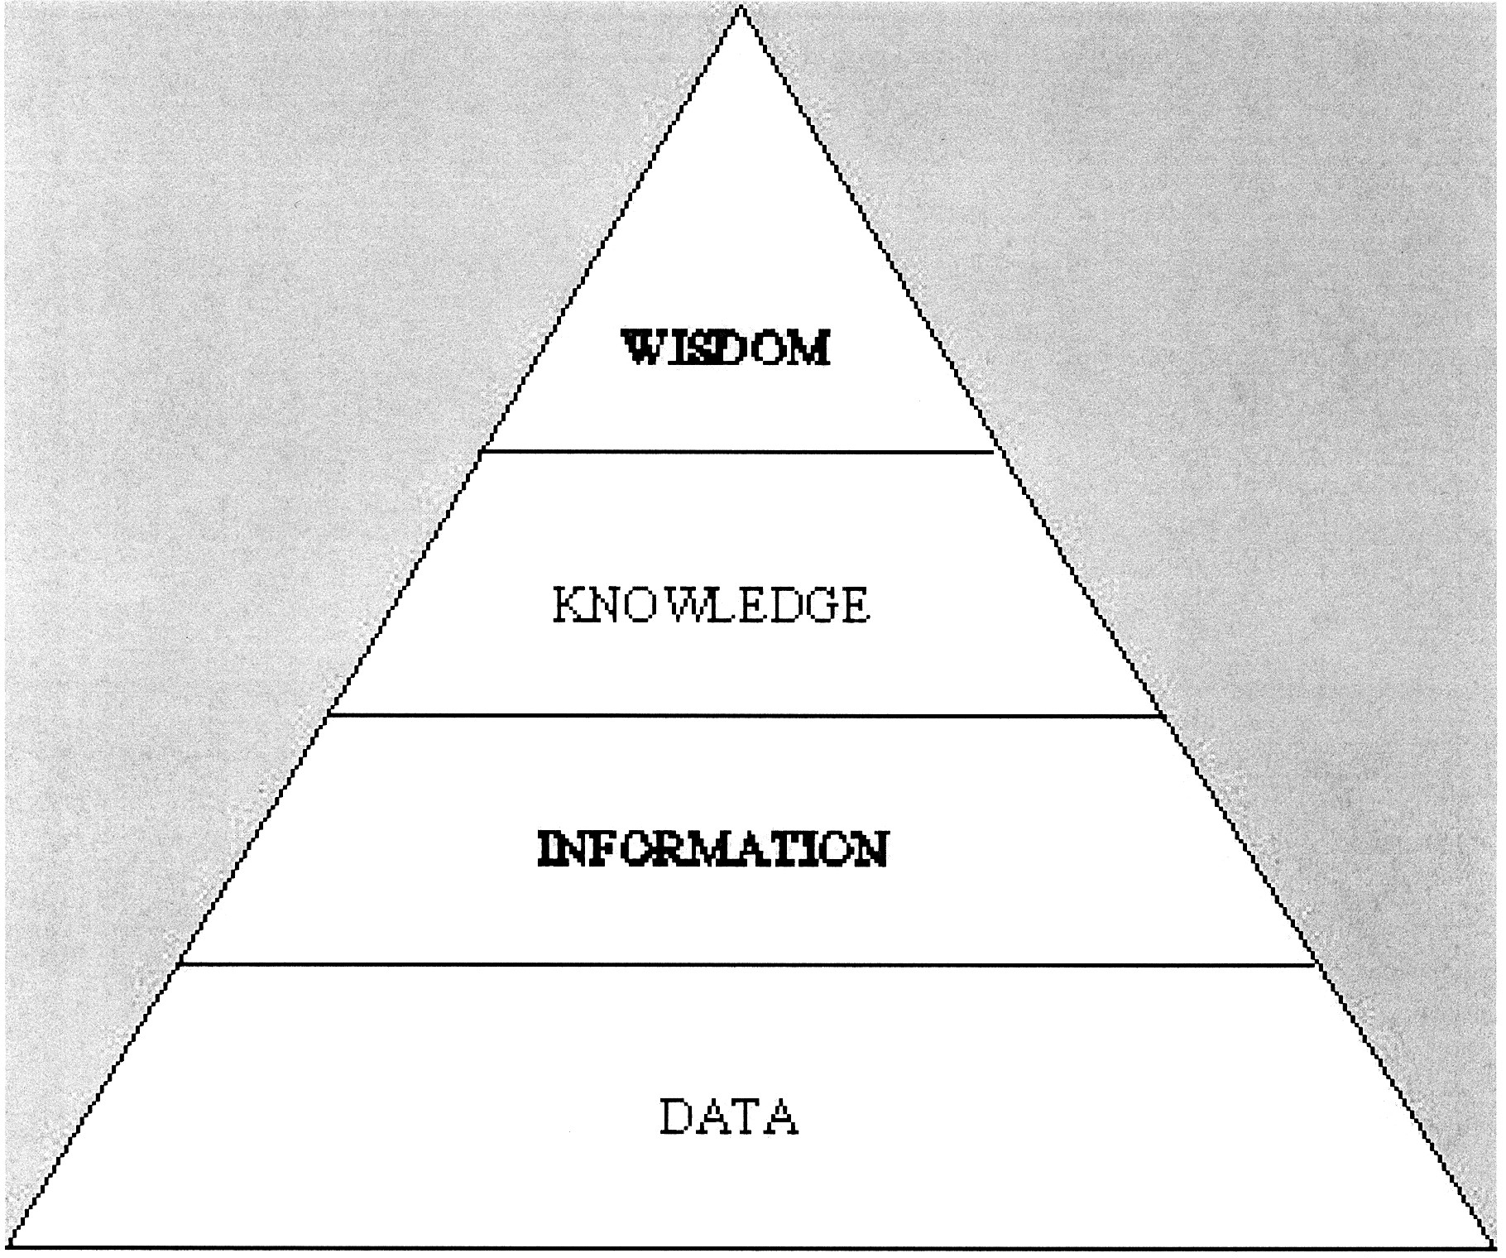
Model of refinement
Weiner promotes the mythology

Slide 26
How the information model matters:
  Treated as a “thing”, information is capital, a precious resource
  BUT, information is the result of work, interactions of sensors and humans
  Sensor webs depend on a more social view of information…

Slide 27
A social model of information
Goguen: an interpretation of a configuration of signs for which some social group is accountable.
Bateson: “a difference that makes a difference”

Slide 28
So, here is the citation:
Bateson, Gregory (1972). Steps to an Ecology of Mind: Collected Essays in Anthropology, Psychiatry, Evolution, and Epistemology. University Of Chicago Press. ISBN 0-226-03905-6
And some context:
Gregory Bateson, a psychologist, married Margaret Mead.
  Participated with Shannon, Weaver, von Neumann, Weiner, and other in the Macy Conferences (1940s-50s) – which defined « cybernetics » and modern information theory.
Count Korzybski (« The map is not the territory ») was not far away…
Notes:
Important moments: when multiple disciplines start sharing their ways of looking at the world. We have been stuck with the initial statements of the engineers who came to Macy, not the result of the discussion!

Slide 29
Bateson’s experiment no consent form needed!
Hold your hand perfectly still, palm upwards and resting comfortably on a table. With your other hand, drop a small coin into the palm.
You will feel the impact, and if the coin is cold, you will feel the coldness of the metal. Soon however, you will feel nothing. The nerve cells don't bother repeating themselves. They will only report to the brain when something changes.
Information is difference.
Notes:
A lizard hunting insects operates on the same principle. The lizard's eye only reports movement to the lizard's brain. If the hunted insect settles on a leaf, the lizard literally cannot see it. But the moment the insect starts to move, whop, the lizard can see it again, and the tongue flickers out and catches it.
But there are differences and differences. Information is difference that makes a difference. You were probably aware, as you dropped the coin into your palm, your eyes told you automatically, without your brain even asking, what the value of the coin was; but you were probably not aware what date it was minted. This is because (unless you are a numismatist) the value of the coin makes a difference to you whereas its date doesn't.
What is it that makes a difference to a lizard, to a numismatist, to you? Surely not the same things. What is information for the lizard is not information for you, and what is information for you is not information for the lizard.
This is why the perspective of information is important. Perspective defines what counts as information at all, perspective defines to whom the information makes a difference.

Slide 30
But a difference that makes a difference
But there are differences and differences…
  As you dropped the coin into your palm,
  your eyes told you automatically,
  without your brain even asking,
  what the value of the coin was;
but you were probably not aware what date it was minted.
This is because (unless you are a numismatist) the value of the coin makes a difference to you whereas its date doesn't.

Slide 31
A matter of perspective
Bateson continued with a story of lizard detecting an incoming insect on a leaf.
What is information for the lizard is not information for you, and what is information for you is not information for the lizard.
Perspective defines what counts as information at all, perspective defines to whom the information makes a difference.
And hence to Goguen’s social interpretation of signs- and the importance of responsibility…
Notes:
Back to Goguen; a social group has to take responsibility

Slide 32
Back to Sensors
How the information model matters:
  Treated as a “thing”, information is capital, a precious resource
  BUT, information is the result of work, interactions of sensors and humans
  The value of information is NOT inherent, but the result of perspective (people, purpose, place…)

Slide 33
Limitations of transformational viewpoint
Tobler’s view on transformations:
  focus on invariance; what is preserved
BUT, it is exactly the opposite:
  focus on what is deliberately lost;
  what does not matter and what does;
the difference that makes a difference

Slide 34
And a consequence (or two)
van Foerster: « you can turn a library upside down, but not a drop of information will flow out »
All writing requires an audience; meaning is interpreted by the reader
Notes:
The meaning was not in Shannon’s model, and it has to be considered.

Slide 35
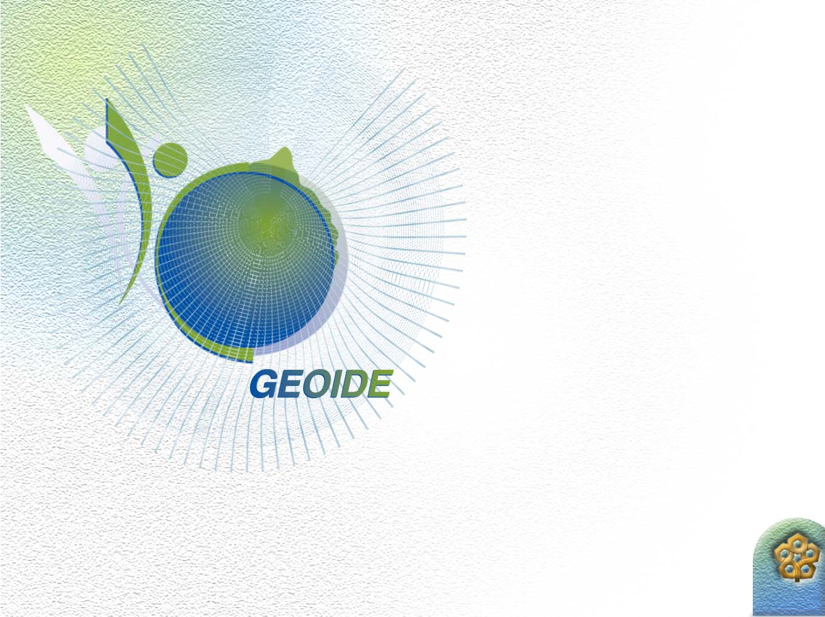
Role of
Networks
Intellectual progress requires mixing up perspectives.
Interaction between disciplines is necessary.
Fresh perspective comes from student participants.

Slide 36
Conclusion
Distributed sensor technology offers new challenges;
Knowledge networks complete the interaction.
Best wishes for a productive Summer School!

Slide 37
Disclaimer
The preceeding slide show was neither accurate, nor complete, and its quality is entirely in the hands of the audience.
Any resemblence of the fictional characters referenced to well-known academics is not coincidental.
No animals were hurt in the making of this entertainment.
Notes:
To end in the spirit of this conference…

